Slide 1
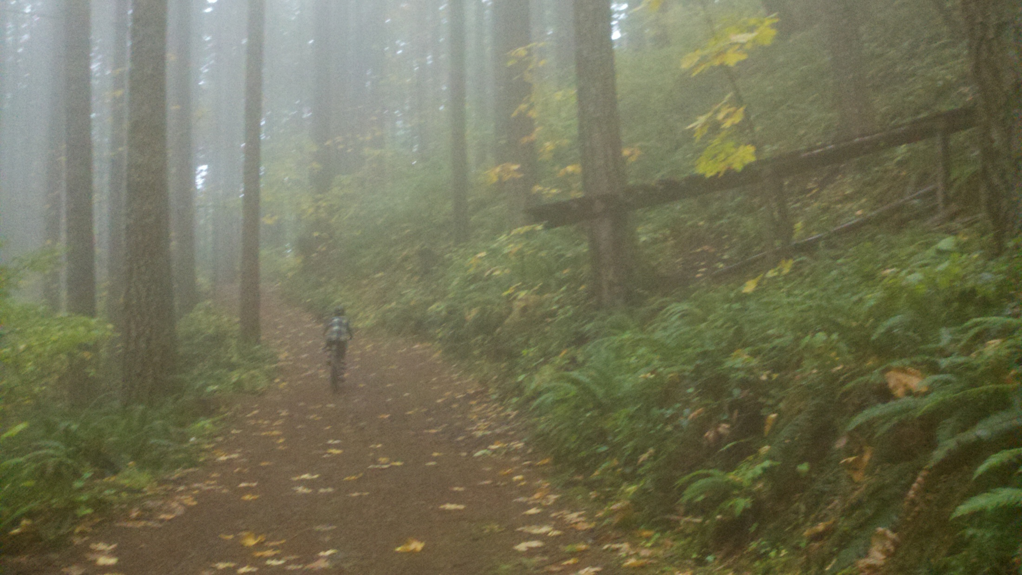

Slide 2
Mossy Bigleaf Maple at Blackrock, Coast Hills Oregon

